Slide 1
Relational Algebra

Slide 2
Relational Query Languages
Query languages: Allow manipulation and retrieval of data from a database.
Relational model supports simple, powerful QLs:
Strong formal foundation based on logic.
Allows for optimization.
Query Languages != programming languages
QLs not expected to be “Turing complete”.
QLs not intended to be used for complex calculations.
QLs support easy, efficient access to large data sets.

Slide 3
Relational Query Languages
Two mathematical Query Languages form the basis for “real” query languages (e.g. SQL), and for implementation:
Relational Algebra: More operational, very useful for representing execution plans.
Basis for SEQUEL
Relational Calculus: Let’s users describe WHAT they want, rather than HOW to compute it. (Non-operational, declarative.)
Basis for QUEL

Slide 4
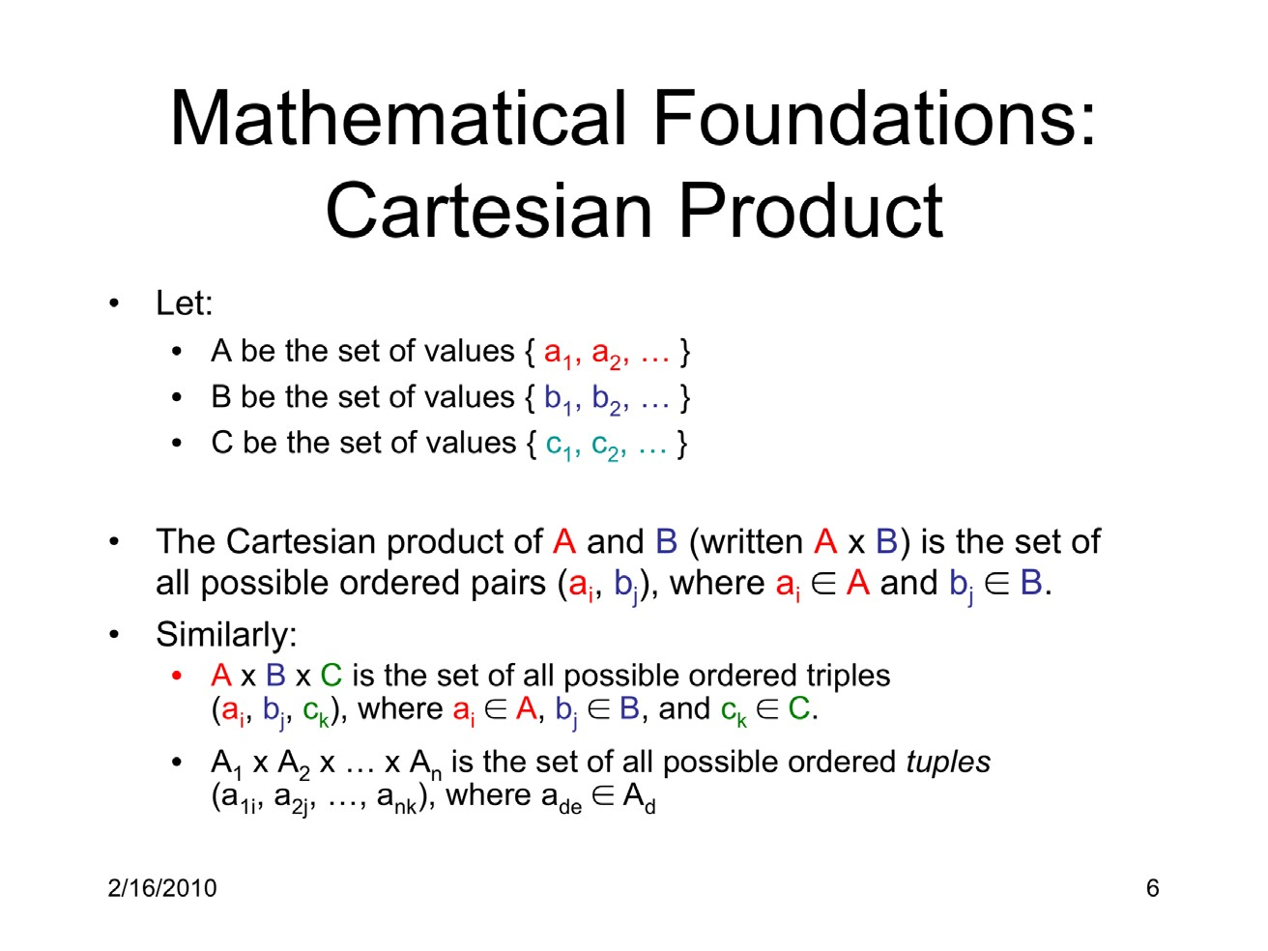

Slide 5
Cartesian Product Example
A = {small, medium, large}
B = {shirt, pants}
A X B | Shirt | Pants
Small | (Small, Shirt) | (Small, Pants)
Medium | (Medium, Shirt) | (Medium, Pants)
Large | (Large, Shirt) | (Large, Pants)
A x B = {(small, shirt), (small, pants), (medium, shirt), (medium, pants), (large, shirt), (large, pants)}
Set notation

Slide 6
Example: Cartesian Product
What is the Cartesian Product of AxB ?
A = {perl, ruby, java}
B = {necklace, ring, bracelet}
What is BxA?
A x B | Necklace | Ring | Bracelet
Perl | (Perl,Necklace) | (Perl, Ring) | (Perl,Bracelet)
Ruby | (Ruby, Necklace) | (Ruby,Ring) | (Ruby,Bracelet)
Java | (Java, Necklace) | (Java, Ring) | (Java, Bracelet)

Slide 7
Mathematical Foundations: Relations
The domain of a variable is the set of its possible values
A relation on a set of variables is a subset of the Cartesian product of the domains of the variables.
Example: let x and y be variables that both have the set of non- negative integers as their domain
• {(2,5),(3,10),(13,2),(6,10)} is one relation on (x, y)
A table is a subset of the Cartesian product of the domains of the attributes. Thus a table is a mathematical relation.
Synonyms:
Table = relation
Row (record) = tuple
Column (field) = attribute
7

Slide 8
Mathematical Relations
In tables, as, in mathematical relations, the order of the tuples does not matter but the order of the attributes does.
The domain of an attribute usually includes NULL, which indicates the value of the attribute is unknown.

Slide 9
What is an Algebra?
Mathematical system consisting of:
Operands --- variables or values from which new values can be constructed.
Operators --- symbols denoting procedures that construct new values from given values.

Slide 10
What is Relational Algebra?
An algebra whose operands are relations or variables that represent relations.
Operators are designed to do the most common things that we need to do with relations in a database.
The result is an algebra that can be used as a query language for relations.
10

Slide 11
Relational Algebra
A collection of operations that users can perform on relations to obtain a desired result
This is an introduction and only covers the algebra needed to represent SQL queries
Select, project, rename
Cartesian product
Joins (natural, condition, outer)
Set operations (union, intersection, difference)
Relational Algebra treats relations as sets: duplicates are removed
11

Slide 12
Relation Instance vs. Schema
Schema of a relation consists of
The name of the relation
The fields of the relation
The types of the fields
For the Student table
SID | Name | Login | DoB | GPA
55515 | Smith | smith@ccs | Jan 10,1990 | 3.82
55516 | Jones | jones@hist | Feb 11, 1992 | 2.98
55517 | Ali | ali@math | Sep 22, 1989 | 3.11
55518 | Smith | smith@math | Nov 30, 1991 | 3.32
Schema = Student(SID int, Name char(20), Login char(20), DoB date, GPA real )
Instance of a relation is an actual collection of tuples
Table with rows of values
Database schema is the schema of the relations in a database
12

Slide 13
Relational Algebra
One or
Operation
Resulting Relation
more relations
For each operation:
both the operands and the result are relations

Slide 14
Facts on relational algebra queries
A query is applied to relation instances, and the result of a query is also a relation instance.
Schemas of input relations for a query are fixed
But query will run regardless of instance.
The schema for the result of a given query is also fixed
Determined by definition of query language constructs.
Positional vs. named-field notation:
Positional notation easier for formal definitions, named field notation more readable.
Both used in SQL

Slide 15
Basic Relational Algebra Operations
Basic operations:
Selection ( σ ): Selects a subset of tuples from a relation.
Projection ( π ): Selects columns from a relation.
Cross-product ( × ): Allows us to combine two relations.
Set-difference ( − ): Tuples in relation 1, but not in relation 2.
Union ( ∪ ): Tuples in relation 1 and in relation 2.
Additional operations:
Intersection, join, division, renaming: Not essential, but (very) useful.
Each operation returns a relation, operations can be composed (Algebra is “closed”)
Contains the closure property
Since operators’ input is a relation and its output is a relation we can string these operators together to form a more complex
15

Slide 16
Basic Operation: Projection
𝜋
Deletes attributes that are not in projection list.
Schema of result contains exactly the fields in the projection list, with the same names that they had in the input relation.
Syntax: π_{𝑓1, 𝑓2 …} (Relation)
Projection operator has to eliminate duplicates.
SID | Name | Login | DoB | GPA
55515 | Smith | smith@ccs | Jan 10,1990 | 3.82
55516 | Jones | jones@hist | Feb 11, 1992 | 2.98
55517 | Ali | ali@math | Sep 22, 1989 | 3.11
55518 | Smith | smith@math | Nov 30, 1991 | 3.32
^{π}𝑆id, 𝑁a m e ^{(S𝑓)}
π_{Sid} (S𝑓)
SID | Name
55515 | Smith
55516 | Jones
55517 | Ali
55518 | Smith
SID
55515
55516
55517
55518
16

Slide 17
Basic Operations: Select
𝜎
Selects rows that satisfy the selection condition.
No duplicates in result (Why?)
Schema of result is identical to schema of input relation
Selection predicates can include: <, >, =, !=, and, or, not
SID | Name | Login | DoB | GPA
55515 | Smith | smith@ccs | Jan 10,1990 | 3.82
55516 | Jones | jones@hist | Feb 11, 1992 | 2.98
55517 | Ali | ali@math | Sep 22, 1989 | 3.11
55518 | Smith | smith@math | Nov 30, 1991 | 3.32
^{σ}𝑆 i d
55516 ^{(S1)}
>
Examples:
SID | Name | Login | DoB | GPA
55517 | Ali | ali@math | Sep 22, 1989 | 3.11
55518 | Smith | smith@math | Nov 30, 1991 | 3.32
^{• σ}𝑆id _{! =}
55516 ^{(S1)}
•
^{σ}𝑁a m e Smith ‘ ^{(S1)}
′
=
17
• Syntax: σ_{𝐶onditional} (Relation)

Slide 18
Operator composition example.
Select and Project
SID | Name | Login | DoB | GPA
55515 | Smith | smith@ccs | Jan 10,1990 | 3.82
55516 | Jones | jones@hist | Feb 11, 1992 | 2.98
55517 | Ali | ali@math | Sep 22, 1989 | 3.11
55518 | Smith | smith@math | Nov 30, 1991 | 3.32
^{π}𝑆id, 𝑁a m e ^{( σ}𝑆id > 55516 ^{(S1))}
SID | Name
55517 | Ali
55518 | Smith

Slide 19
S1
Union
∪
SID | Name | Login | DoB | GPA
55515 | Smith | smith@ccs | Jan 10,1990 | 3.82
55516 | Jones | jones@hist | Feb 11, 1992 | 2.98
55517 | Ali | ali@math | Sep 22, 1989 | 3.11
55518 | Smith | smith@math | Nov 30, 1991 | 3.32
Takes two input relations, which must be union- compatible:
Same number of fields.
`Corresponding’ fields have the same type.
S1 U S2
S2
SID | Name | Login | DoB | GPA
55515 | Chen | chen@ccs | Jan 10,1990 | 3.01
55519 | Alton | alton@hist | Jun 11, 1992 | 2.07
55517 | Ali | ali@math | Sep 22, 1989 | 3.11
55518 | Smith | smith@math | Nov 30, 1991 | 3.32
SID | Name | Login | DoB | GPA
55515 | Smith | smith@ccs | Jan 10,1990 | 3.82
55516 | Jones | jones@hist | Feb 11, 1992 | 2.98
55517 | Ali | ali@math | Sep 22, 1989 | 3.11
55518 | Smith | smith@math | Nov 30, 1991 | 3.32
55515 | Chen | chen@ccs | Jan 10,1990 | 3.01
55519 | Alton | alton@hist | Jun 11, 1992 | 2.07

Slide 20
Intersection ∩
S1
SID | Name | Login | DoB | GPA
55515 | Smith | smith@ccs | Jan 10,1990 | 3.82
55516 | Jones | jones@hist | Feb 11, 1992 | 2.98
55517 | Ali | ali@math | Sep 22, 1989 | 3.11
55518 | Smith | smith@math | Nov 30, 1991 | 3.32
Occurs in S1 and S2
S1 ∩ S2
S2
SID | Name | Login | DoB | GPA
55517 | Ali | ali@math | Sep 22, 1989 | 3.11
55518 | Smith | smith@math | Nov 30, 1991 | 3.32
S2
SID | Name | Login | DoB | GPA
55515 | Chen | chen@ccs | Jan 10,1990 | 3.01
55519 | Alton | alton@hist | Jun 11, 1992 | 2.07
55517 | Ali | ali@math | Sep 22, 1989 | 3.11
55518 | Smith | smith@math | Nov 30, 1991 | 3.32
Set difference
Occurs in S1 but not in S2
S1 – S2
SID | Name | Login | DoB | GPA
55515 | Smith | smith@ccs | Jan 10,1990 | 3.82
55516 | Jones | jones@hist | Feb 11, 1992 | 2.98
20

Slide 21
Cartesian Product
Also referred to as cross-product or product.
Two input relations.
Each tuple of the one relation is paired with each tuple of the other relation.
Result schema has one attribute per attribute of both input relations, with attribute names `inherited’ if possible.
In the result, there may be two attributes with the same name, e.g. both S1 and R1 have an attribute called sid.
Then, apply the renaming operation, e.g.
ρS1(1→ sid1,5 → sid 2)(R1)

Slide 22
S1
Cross-Product x
SID | Name | Login | DoB | GPA
55515 | Smith | smith@ccs | Jan 10,1990 | 3.82
55516 | Jones | jones@hist | Feb 11, 1992 | 2.98
Each row within S1 is paired with each row of C1
S1 x C1
C1
CId | Grade
History 101 | C
Biology 220 | A
Anthro 320 | B
Music 101 | A
SID | Name | Login | DoB | GPA | CID | Grade
55515 | Smith | smith@ccs | Jan 10,1990 | 3.82 | History 101 | C
55515 | Smith | smith@ccs | Jan 10,1990 | 3.82 | Biology 220 | A
55515 | Smith | smith@ccs | Jan 10,1990 | 3.82 | Anthro 320 | B
55515 | Smith | smith@ccs | Jan 10,1990 | 3.82 | Music 101 | A
55516 | Jones | jones@hist | Feb 11, 1992 | 2.98 | History 101 | C
55516 | Jones | jones@hist | Feb 11, 1992 | 2.98 | Biology 220 | A
55516 | Jones | jones@hist | Feb 11, 1992 | 2.98 | Anthro 320 | B
55516 | Jones | jones@hist | Feb 11, 1992 | 2.98 | Music 101 | A
Result schema has one field per field of S1 and C1, with field names
`inherited’ if possible.

Slide 23
Rename fields or table
Renames relations / attributes, without changing the relation instance.
ρS(A1, A2,..., An)(R)
relation R is renamed to S, attributes are renamed A1, . . ., An
Rename only some attributes
ρS(1− • A1,...,k− • Ak)(R)
using the positional notation to reference attributes
No renaming of attributes
ρS(R)
•
23

Slide 24
S1
Rename ρ
SID | Name | Login | DoB | GPA
55515 | Smith | smith@ccs | Jan 10,1990 | 3.82
55516 | Jones | jones@hist | Feb 11, 1992 | 2.98
Reassign the field names
ρ(C(1-> S1.sid, 6->C1.sid), S1 X C1)
C1
Sid | CId | Grad e
55515 | History 101 | C
55516 | Biology 220 | A
55517 | Anthro 320 | B
55518 | Music 101 | A
C
S1.SID | Name | Login | DoB | GPA | C1.Sid | CID | Grade
55515 | Smith | smith@ccs | Jan 10,1990 | 3.82 | 55515 | History 101 | C
55515 | Smith | smith@ccs | Jan 10,1990 | 3.82 | 55516 | Biology 220 | A
55515 | Smith | smith@ccs | Jan 10,1990 | 3.82 | 55517 | Anthro 320 | B
55515 | Smith | smith@ccs | Jan 10,1990 | 3.82 | 55518 | Music 101 | A
55516 | Jones | jones@hist | Feb 11, 1992 | 2.98 | 55515 | History 101 | C
55516 | Jones | jones@hist | Feb 11, 1992 | 2.98 | 55516 | Biology 220 | A
55516 | Jones | jones@hist | Feb 11, 1992 | 2.98 | 55517 | Anthro 320 | B
55516 | Jones | jones@hist | Feb 11, 1992 | 2.98 | 55518 | Music 101 | A
Prepend the name of the original relation to the fields having a collision
Naming columns and result set to C
24

Slide 25
S1
Conditional Join
SID | Name | Login | DoB | GPA
55515 | Smith | smith@ccs | Jan 10,1990 | 3.82
55516 | Jones | jones@hist | Feb 11, 1992 | 2.98
Accepts a conditional
Operation equivalent to:
C1
CId | Grade
History 101 | C
Biology 220 | A
Anthro 320 | B
Music 101 | A
• S1 _{C} C1 = σ_{C} (S1 x C1))
Filters out tuples according to the conditional expression
S1
gpa > 3.0 ^{C1}
SID | Name | Login | DoB | GPA | CID | Grade
55515 | Smith | smith@ccs | Jan 10,1990 | 3.82 | History 101 | C
55515 | Smith | smith@ccs | Jan 10,1990 | 3.82 | Biology 220 | A
55515 | Smith | smith@ccs | Jan 10,1990 | 3.82 | Anthro 320 | B
55515 | Smith | smith@ccs | Jan 10,1990 | 3.82 | Music 101 | A
Conditional Join is equivalent to: Cartesian project (x) Selection (σ)

Slide 26
S1
Equijoin
SID | Name | Login | DoB | GPA
55515 | Smith | smith@ccs | Jan 10,1990 | 3.82
55516 | Jones | jones@hist | Feb 11, 1992 | 2.98
C
What does it do: performs a filtered Cartesian product
Filters out tuples where the
C1
Sid | CId | Grad e
55515 | History 101 | C
55516 | Biology 220 | A
55517 | Anthro 320 | B
55518 | Music 101 | A
attribute that have the same name have a different value
S
S1.sid = C1.sid ^{C1}
Only one copy of Sid is in the resultant relation
SID | Name | Login | DoB | GPA | CID | Grade
55515 | Smith | smith@ccs | Jan 10,1990 | 3.82 | History 101 | C
55516 | Jones | jones@hist | Feb 11, 1992 | 2.98 | Biology 220 | A

Slide 27
S1
Natural Join
SID | Name | Login | DoB | GPA
55515 | Smith | smith@ccs | Jan 10,1990 | 3.82
55516 | Jones | jones@hist | Feb 11, 1992 | 2.98
What does it do: performs a filtered Cartesian product
Filters out tuples where the
C1
Sid | CId | Grad e
55515 | History 101 | C
55516 | Biology 220 | A
55517 | Anthro 320 | B
55518 | Music 101 | A
attribute that have the same name have a different value
No need to specify field list
S1 C1
SID | Name | Login | DoB | GPA | CID | Grade
55515 | Smith | smith@ccs | Jan 10,1990 | 3.82 | History 101 | C
55516 | Jones | jones@hist | Feb 11, 1992 | 2.98 | Biology 220 | A
Natural join is equivalent to: Cartesian project (x) Selection (σ)
Projection (π)
27

Slide 28
Precedence of Relational Operators
•1. [ σ, π, ρ] (highest).
•2. [ Χ, ⋈]
•3. ∩
•4. [ ∪, — ]
28

Slide 29
Schema of the Resulting Table
Union, intersection, and difference operators
the schemas of the two operands must be the same, so use that schema for the result.
Selection operator
schema of the result is the same as the schema of the operand.
Projection operator
list of attributes determines the schema.
29

Slide 30
Relational Algebra: Summary
The relational model has rigorously defined query languages that are simple and powerful.
Relational algebra is more operational
Useful as internal representation for query evaluation plans
Several ways of expressing a given query
A query optimizer should choose the most efficient version

Slide 31
Relational Algebra
Like ERM modeling there are many ways to solve the problem at hand
Given the theory behind RA, a sophisticated query optimization engineer can write algorithms that optimize a query
Theory in practice

